Slide 1
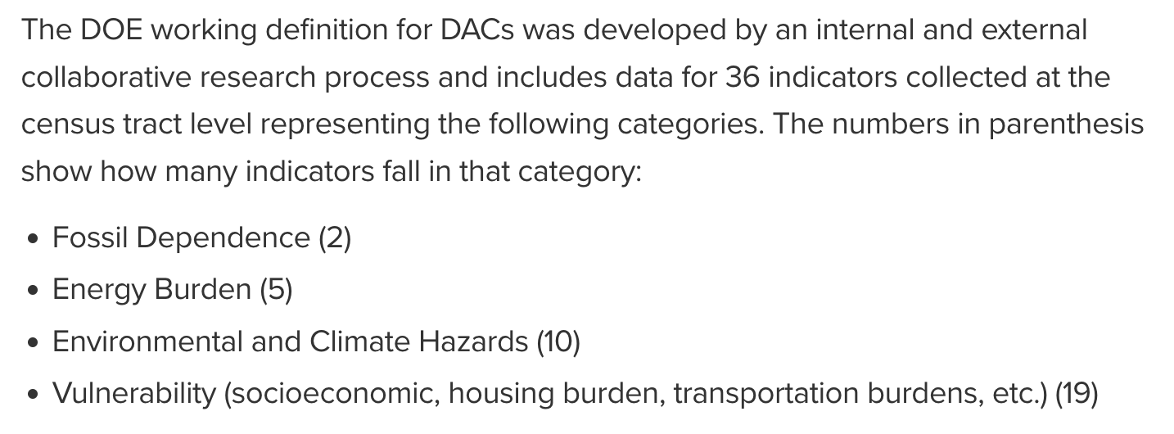
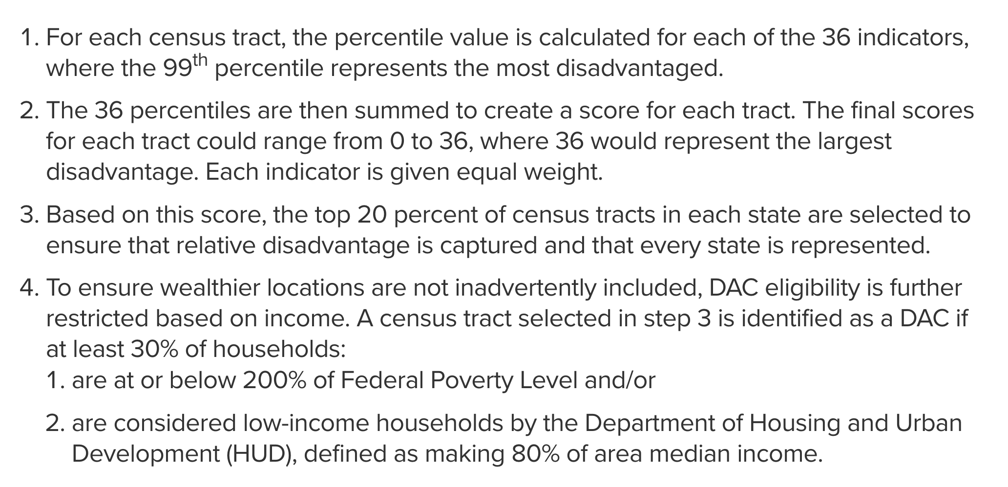
Department of Energy

Slide 2
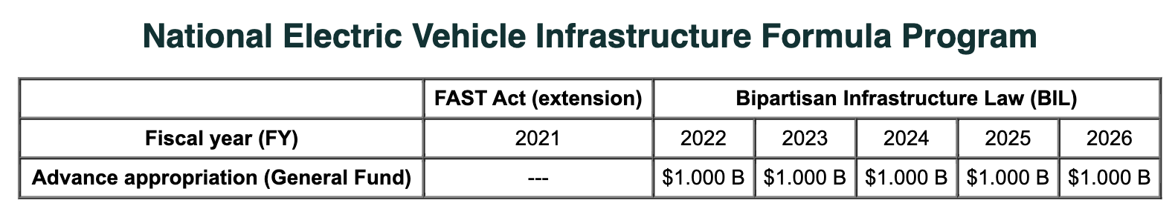
NEVI Formula Program
Justice40 guides the National Electric Vehicle Infrastructure (NEVI) Formula Program
provides funding to States to strategically deploy EV charging infrastructure and established an interconnected network to facilitate data collection, access, and reliability
Federal share of projects is 80%
Only includes EV infrastructure open to the public
In general, projects must be located on a designated alternative fuel corridor
States must submit a plan to the USDOT about how the state intends to use NEVI Formula funds
Private entities can be involved, and can pay the non-federal share of a project
Can cover acquisition/installation of charging infrastructure, operating assistance for up to 5 years, traffic control devices and signage for charging infrastructure, development phases, analytical modeling to evaluate different adoption and use scenarios

Slide 3
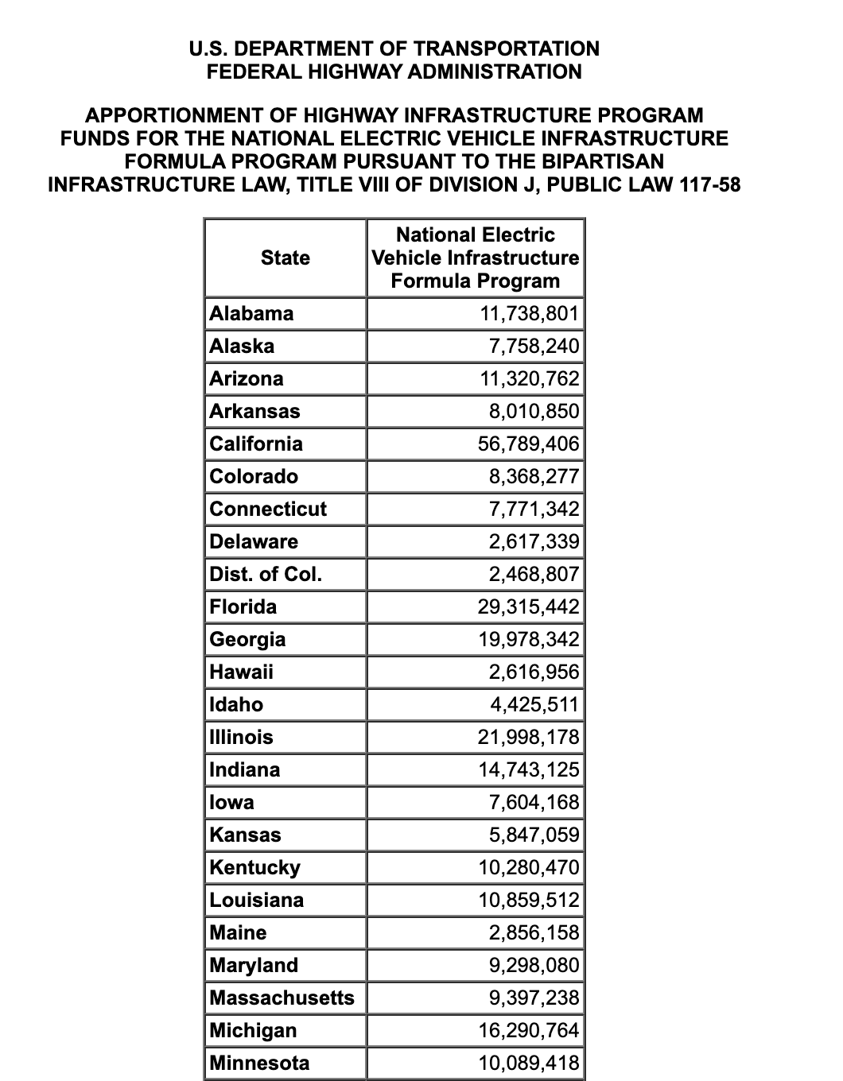
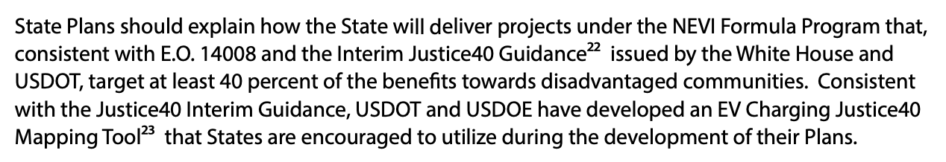
NEVI Plan Guidance (Feb 10, 2022)

Slide 4
